Slide 1
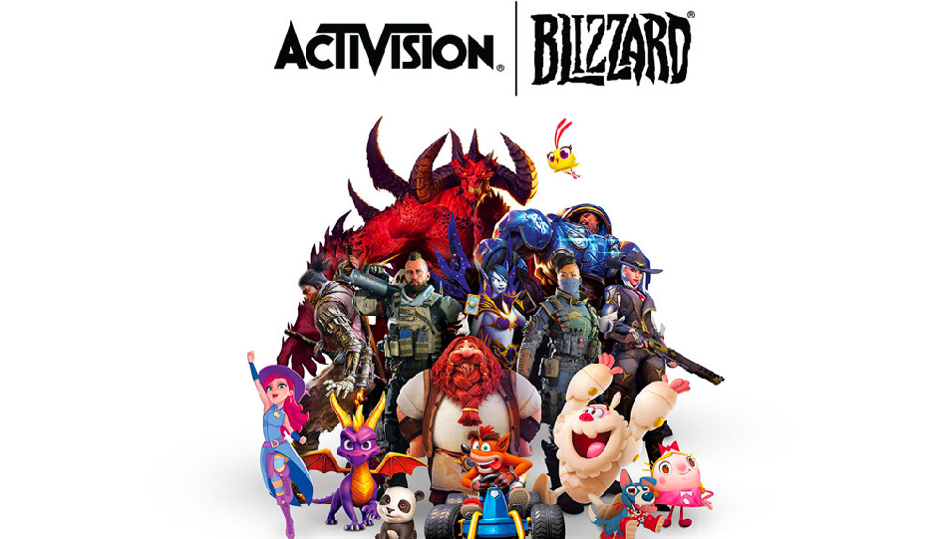
EQUITY RESEARCH
PIC CONSULTING TEAM

Slide 2

Introducción al sector

Slide 3

A C T I V I S I O N B L I Z Z A R D
S E G M E N T O S
T I P O S D E P R O D U C T O S
$5.9M (2019).
Revenue
34.4%
of, Margin

Slide 4

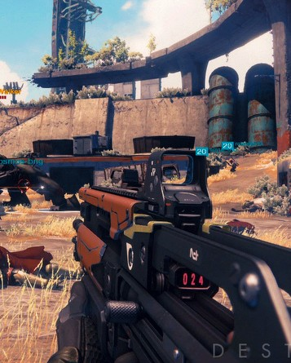
ACTIVISION
ACTIVISION
37% $2.2 M (2019)
Full Games
DLC
Microtransactions

Slide 5
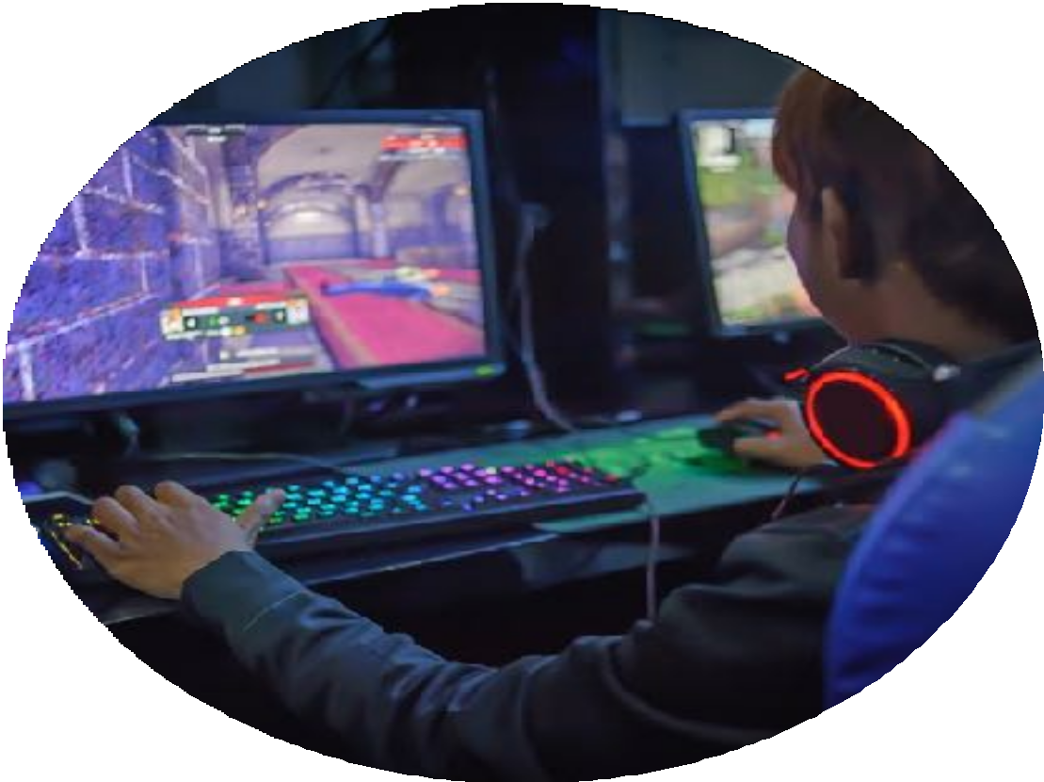
BLIZZARD
29%. $1.7M
(2019)
Full Games
DLCs
Microtransaction
Subscription

Slide 6

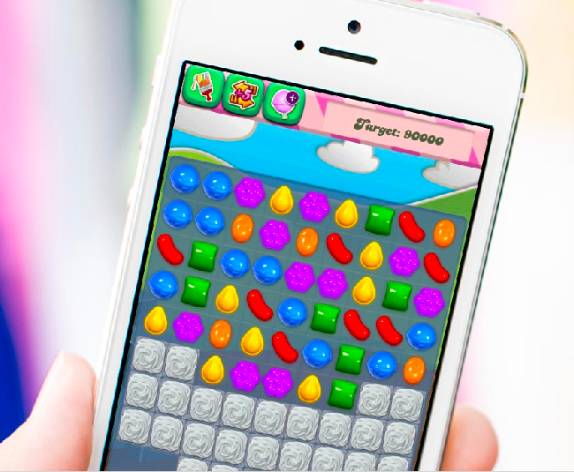
King 34%
Microtransaction
Tropski

Slide 7

Marketing
Distribution: Outlets digital platforms third party
Publicity on-line classical
Production
Development: Product based teams
Copies: in house (europe) + third party
Strong intellectual property defence
Big distributor are a 25% costumer base
Other Aspects

Slide 8
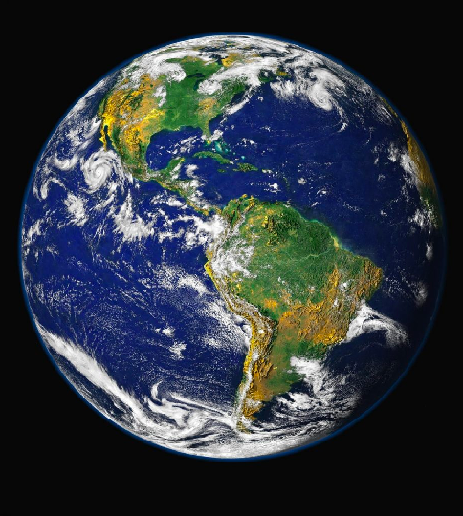

Market Distribution
2019 Total
$152.1BN
+9.6%
48% CHINA TOTAL
$36.5BN US TOTAL 36.98BN

Slide 9

NORTH AMERICA
$39.6BN
ASIA PASIFIC
$73.2BN
+7.6%
+11.7%
MORE
MARKET DISTRIBUTION

Slide 10

EUROPE, MIDDLE EAST & AFRICA
$34.7bn
+11.5%
Latin America
$5.6bn
+11.1%

Slide 11
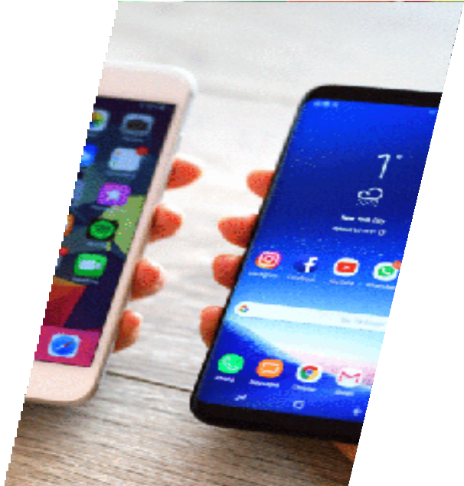
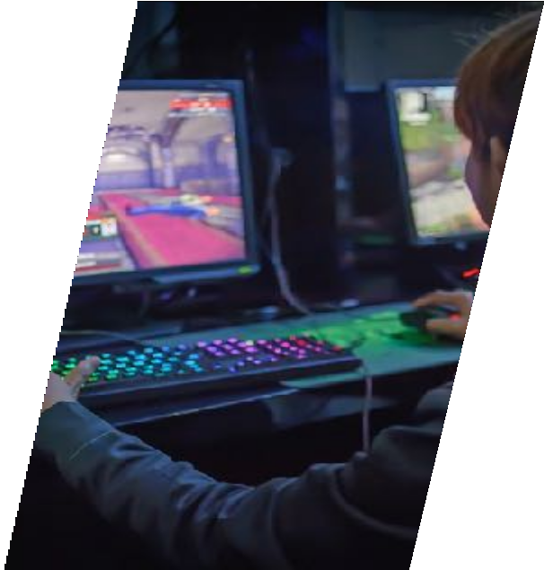
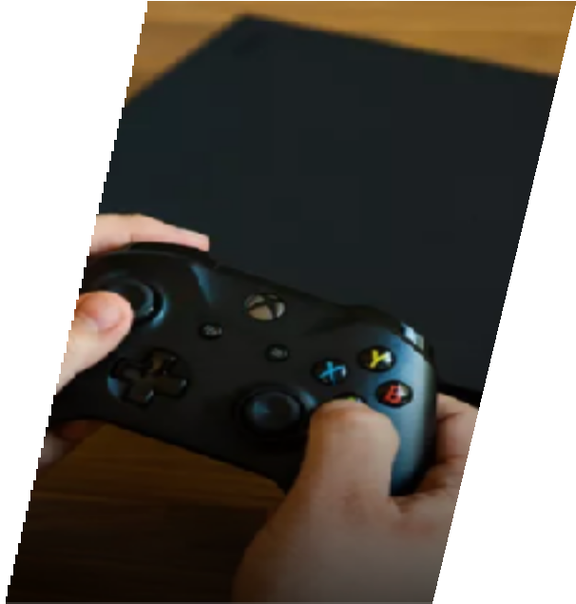
$68.5bn | $32.2bn | $47.9bn
+45% | -15.1% | +13.5%

Slide 12
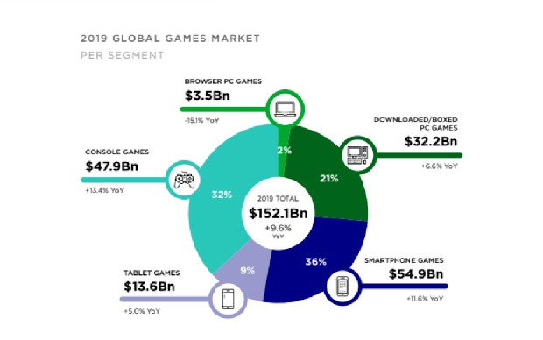

Slide 13


COSTUMER TASTE
DON’T MIND PAY TO WIN
MORE COMPETITIVE
LESS CONSOLES

Slide 14


DON’T LIKE PAY TO WIN
LESS COMPETITIVE
MORE CONSOLE

Slide 15
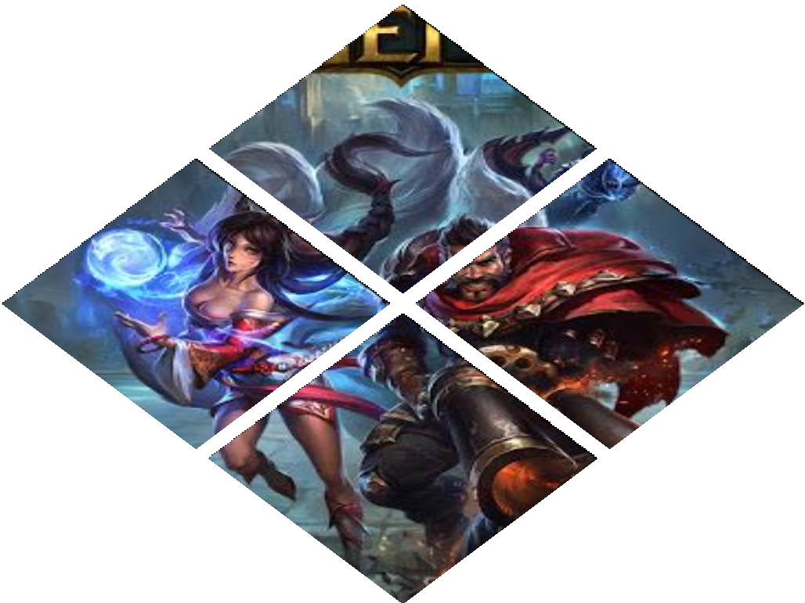

Strengths
Smartphones
Asia
Monetisation
Weaknesses
Consoles
Pc down
Chinese regulation

Slide 16
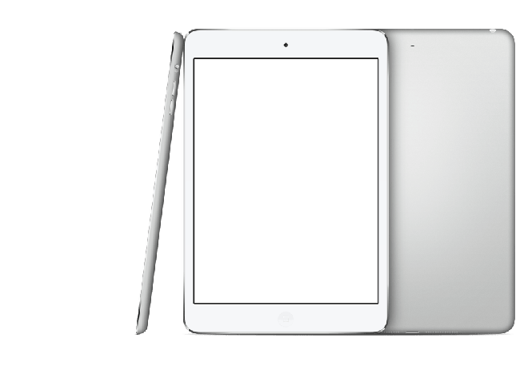


Strengths
Loyal customers
Well implemented microtransactions
Nintendo market
Weaknesses
Lot of expenses because of consumers exigency
Repetitive franchises and Little changes
Strong competitors

Slide 17
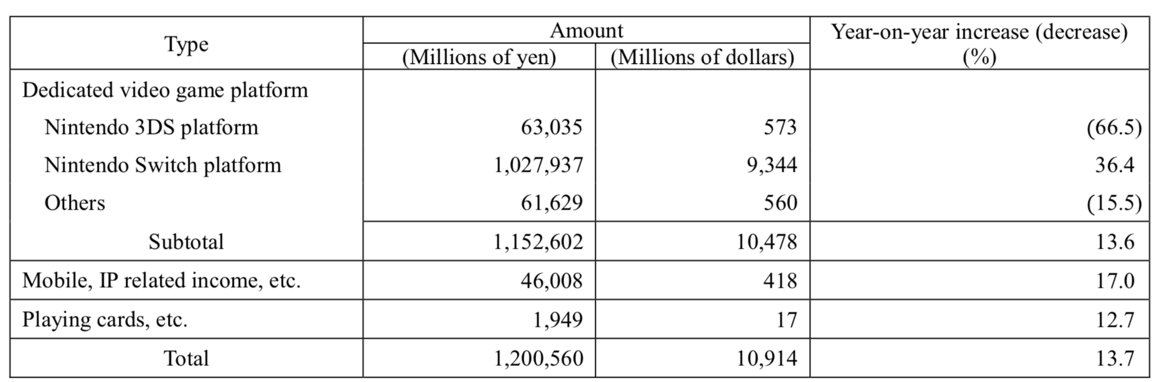
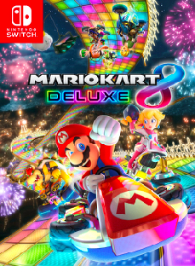
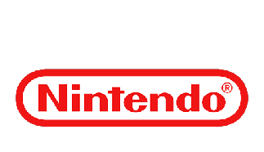
Advantages | Disadvantages
Amazing for offline use, while travelling | Nintendo only has 32% ownership stake in the The Pokemon Company does not
 | own Pokemon Go
Very popular first-party | Activision Blizzard has a better presence on the mobile market through King Digital Entertainment
games:
Mario Kart 8 Deluxe, Super Smash
Bros, Super Mario Odyssey , Zelda:
Breath of the Wild, Pokemon Let's
Go,
Splatoon 2, Super Mario Party
Nintendo’s in game characters are more viable for theme park presentations and other corporate collaborations | Activision Blizzard has a better track record of monetization outside of videogames

Slide 18
No. | Game | Copies sold
1 | Mario Kart 8 Deluxe | 22.96 million^{[1]}
2 | Super Smash Bros. Ultimate | 17.68 million^{[1]}
3 | Super Mario Odyssey | 16.59 million^{[1]}
4 | The Legend of Zelda: Breath of the Wild | 16.34 million^{[1]}
5 | Pokémon Sword and Shield | 16.06 million^{[1]}
6 | Pokémon: Let's Go, Pikachu! and Let's Go, Eevee! | 11.76 million^{[1]}
7 | Splatoon 2 | 9.81 million^{[1]}
8 | Super Mario Party | 9.12 million^{[1]}
9 | New Super Mario Bros. U Deluxe | 5.85 million^{[1]}
10 | Luigi's Mansion 3 | 5.37 million^{[1]}
11 | Super Mario Maker 2 | 5.04 million^{[1]}
12 | The Legend of Zelda: Link's Awakening | 4.19 million^{[1]}
13 | 1-2-Switch | 3.01 million^{[2]}
14 | Mario Tennis Aces | 2.75 million^{[2]}
15 | Fire Emblem: Three Houses | 2.58 million^{[1]}

Slide 19
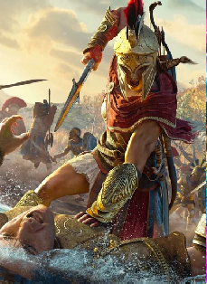

Strengths
When PS 5 is out, effects are expected.
US and Europe are stable markets
Lots of agreements with companies like Tencent
Weaknesses
Activity focus in Europe and US, and disadvantage position in US
The possibilty of Pay-to-win may angry the players
Terrible reputation for releasing unfinished games

Slide 20

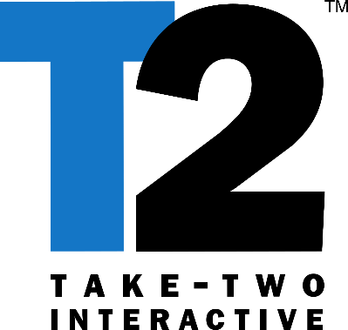
Strengths
40% increase in sales
Strong and beloved franchises
GTA6 might come son
Weaknesses
The loss of a contract with Sony

Slide 21
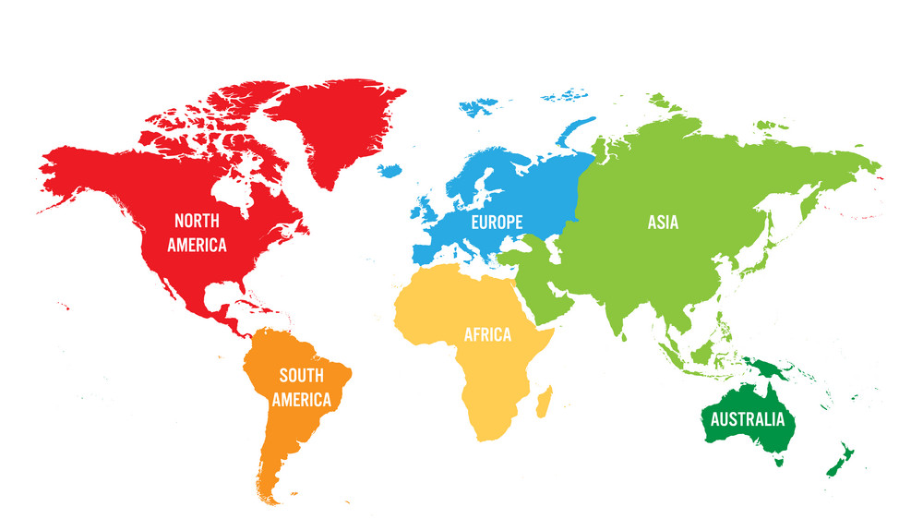


Slide 22
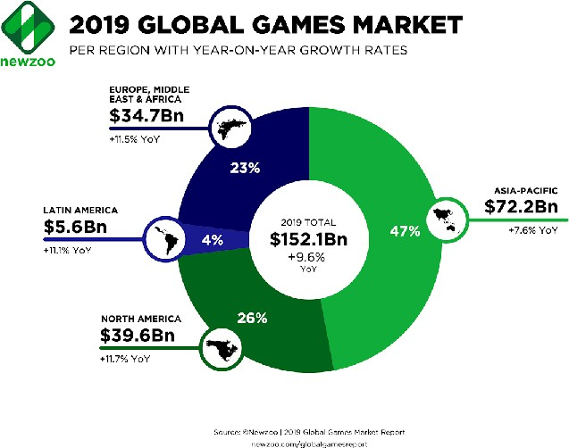

Slide 23
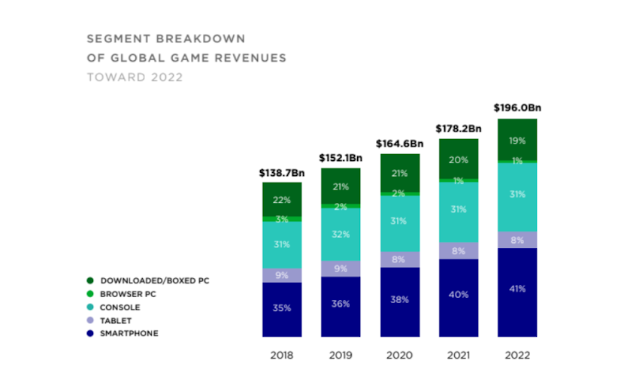

Slide 24
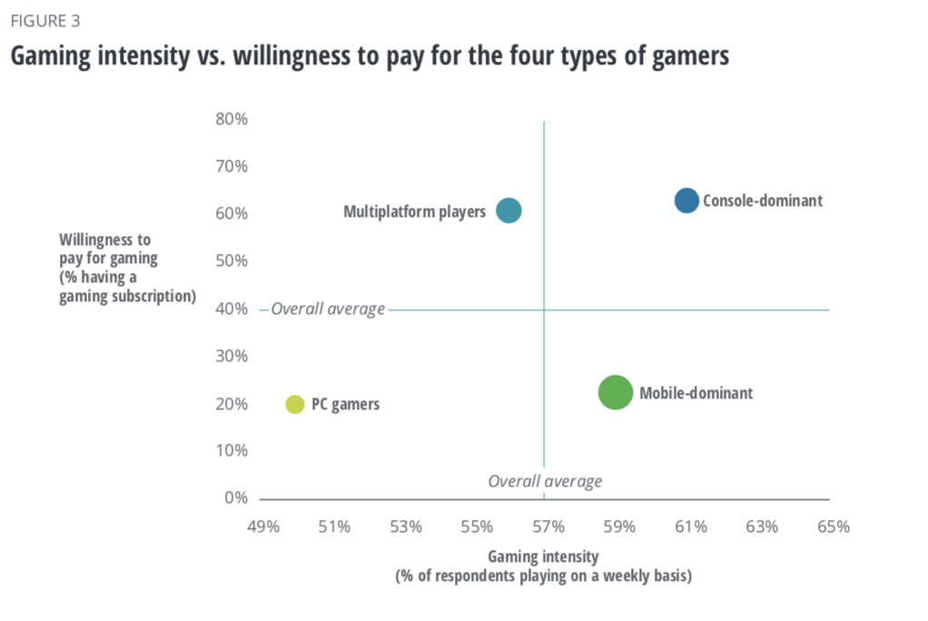

Slide 25
5th Generation

Slide 26
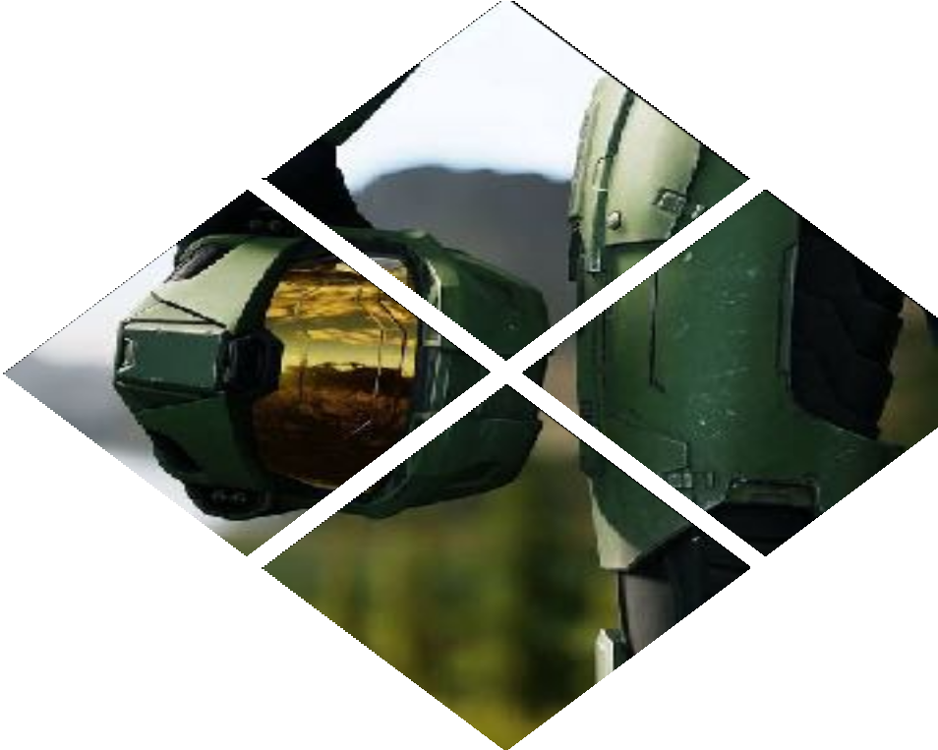
Strengths
Strong well-known games
Loyal gamers
One of the market leaders

Slide 27

Weakness
No new significant franchises
Not attracting new players
Regulation

Slide 28
EQUITY RESEARCH
PIC CONSULTING TEAM

